Slide 1
High clustering
Low intra-cluster distance: Points within the same cluster are tightly grouped around the centroid.
High inter-cluster distance: Centroids of different clusters are far from each other.
High similarity inside clusters: Data points in one cluster are more similar to each other than to points in other clusters.
Silhouette Score is one of method to measure it.
Score close to 1 = high-quality clustering.

Slide 2
Hierarchical clustering
Hierarchical clustering is an unsupervised learning technique that builds a hierarchy of clusters by either merging smaller clusters or splitting larger clusters step by step. Instead of choosing the number of clusters in advance, it builds a tree-like structure called a dendrogram that shows how clusters merge or split at different levels.
It helps identify natural groupings in data and is commonly used in pattern recognition, customer segmentation, gene analysis and image grouping.
Type:
Agglomerative (Bottom-Up): Each data point starts as its own cluster. The closest clusters are merged iteratively. Continues until all points form a single cluster
Divisive (Top-Down): All data points start in one cluster. The cluster is recursively split into smaller clusters.
Most commonly used: Agglomerative clustering

Slide 3
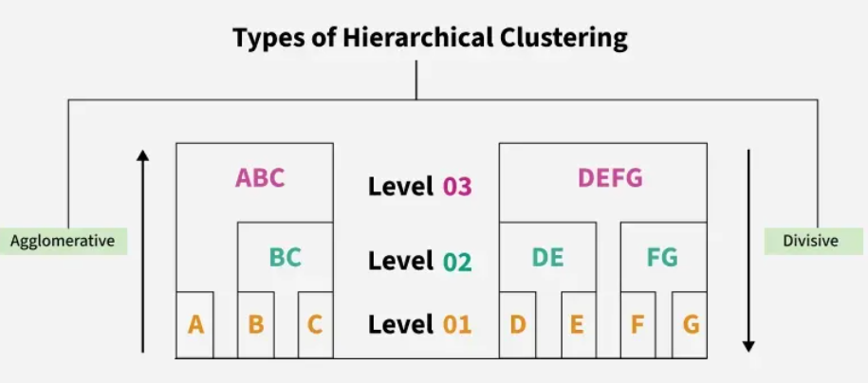

Slide 4
Dendrogram
A dendrogram is like a family tree for clusters.
It shows how individual data points or groups of data merge together.
The bottom shows each data point as its own group and as we move up, similar groups are combined.
The lower the merge point, the more similar the groups are.
It helps us see how things are grouped step by step.

Slide 5
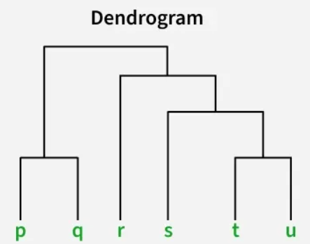
Dendrogram
At the bottom of the dendrogram the points P, Q, R, S and T are all separate.
As we move up, the closest points are merged into a single group.
The lines connecting the points show how they are progressively merged based on similarity.
The height at which they are connected shows how similar the points are to each other; the shorter the line the more similar they are

Slide 6
Dendrogram

Slide 7
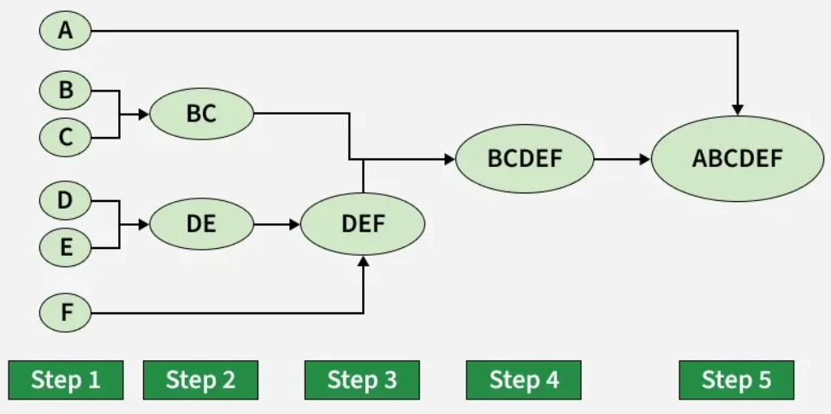
Hierarchical Agglomerative Clustering (HAC)

Slide 8
Workflow for Hierarchical Agglomerative clustering
Start with individual points: Each data point is its own cluster. For example if we have 5 data points we start with 5 clusters each containing just one data point.
Calculate distances between clusters: Calculate the distance between every pair of clusters. Initially since each cluster has one point this is the distance between the two data points.
Merge the closest clusters: Identify the two clusters with the smallest distance and merge them into a single cluster.
Update distance matrix: After merging we now have one less cluster. Recalculate the distances between the new cluster and the remaining clusters.
Repeat steps 3 and 4: Keep merging the closest clusters and updating the distance matrix until we have only one cluster left.
Create a dendrogram: As the process continues we can visualize the merging of clusters using a tree-like diagram called a dendrogram. It shows the hierarchy of how clusters are merged.

Slide 9
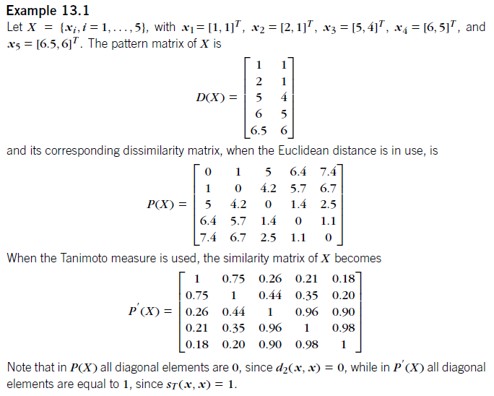

Slide 10
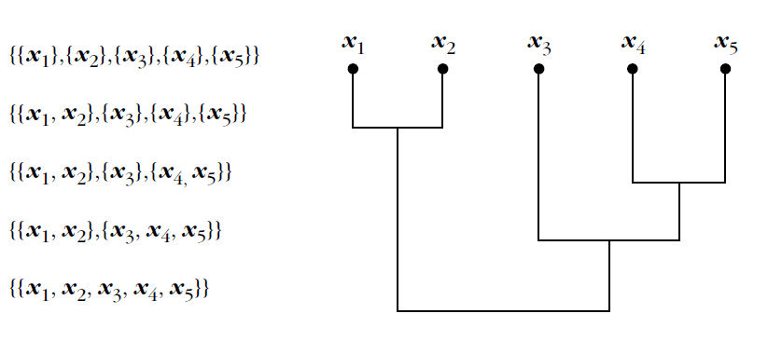
Generalized Agglomerative Sheme (GAS)
A threshold dendrogram, or simply a dendrogram, is an effective means of representing the sequence of clustering produced by an agglomerative algorithm.
x1 and x2 form a new cluster.
x4 and x5 stick together, forming a single cluster.
x3 joins the cluster {x4, x5}
{x1, x2} and {x3, x4, x5} are merged into a single set,X.
Cutting the dendrogram at a specific level results in a clustering.

Slide 11
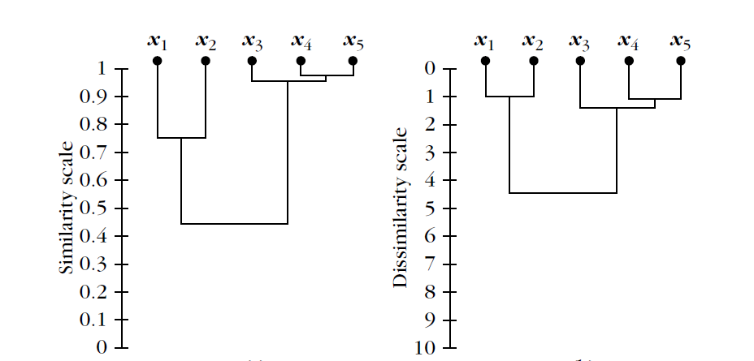
A proximity dendrogram is a dendrogram that takes into account the level of proximity where two clusters are merged for the first time. When a dissimilarity (similarity) measure is in use, the proximity dendrogram is called a dissimilarity (similarity) dendrogram.

Slide 12
Hierarchical Divisive clustering (Top-Down)
Top-down clustering requires a method for splitting a cluster that contains the whole data and proceeds by splitting clusters recursively until individual data have been split into singleton clusters.
Workflow for Hierarchical Divisive clustering :
Start with all data points in one cluster: Treat the entire dataset as a single large cluster.
Split the cluster: Divide the cluster into two smaller clusters. The division is typically done by finding the two most dissimilar points in the cluster and using them to separate the data into two parts.
Repeat the process: For each of the new clusters, repeat the splitting process: Choose the cluster with the most dissimilar points and split it again into two smaller clusters.
Stop when each data point is in its own cluster: Continue this process until every data point is its own cluster or the stopping condition (such as a predefined number of clusters) is met.

Slide 13
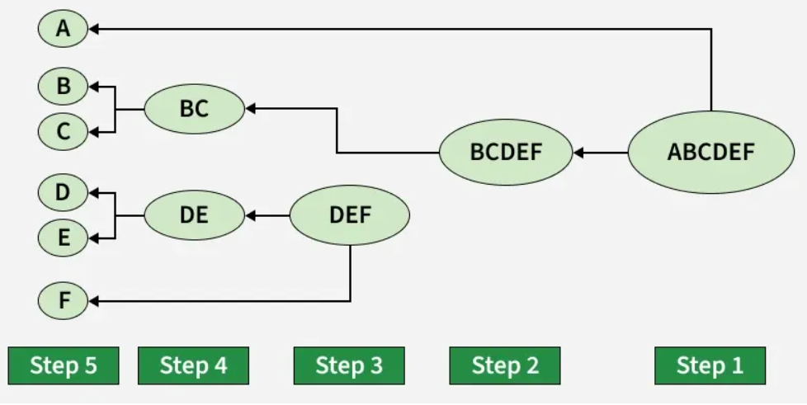
Hierarchical Divisive clustering (Example)

Slide 14

Hierarchical Divisive clustering (Example)
Step 3: Pairwise Distance Calculations
Let us assume:
Point | Coordinates (x, y)
A | (0, 0)
B | (4, 5)
C | (5, 4)
D | (6, 5)
E | (7, 6)
F | (8, 7)
 | A | B | C | D | E | F
A | 0 | 6.40 | 6.40 | 7.81 | 9.22 | 10.63
B | 6.40 | 0 | 1.41 | 2.00 | 2.83 | 4.24
C | 6.40 | 1.41 | 0 | 1.41 | 2.83 | 4.24
D | 7.81 | 2.00 | 1.41 | 0 | 1.41 | 2.83
E | 9.22 | 2.83 | 2.83 | 1.41 | 0 | 1.41
F | 10.63 | 4.24 | 4.24 | 2.83 | 1.41 | 0
A is far from others → First split.

Slide 15
Hierarchical Divisive clustering (Example)
Dendrogram with Heights
Divisive Clustering Using Distances
Step 1: Split ABCDEF
A has large distances
Split: {A} {B C D E F}
Step 2: Split BCDEF
Observe: B & C close (1), D, E, F close among themselves
Split: {B C} {D E F}
Step 3: Split DEF
D & E closest (1)
Split: {D E} {F}
8.1
|
-----------------
| |
{A} 4.2 {B,C,D,E,F}
/ \
{B,C} 2.8 {D,E,F}
| / \
| {D,E} {F}
/ \ / \
1.41 1.41 1.41 1.41
{B} {C} {D} {E}

